Slide 1


Broadsoft Consulting Company
Weather forecasting to boost sales
Presentation by the Data Team
23rd January, 2026

Slide 2

Broadsoft Consulting Company
Table of Contents
Team Slide
Problem
Solution
Data Source
Insights from Data
Data Engineering
Models
Evaluation
Forecast
Value

Slide 3
Broadsoft Consulting Company
Team contribution
Ms Binder
Ms Salchegger
Ms Kern
Preprocessing
Baseline Models
Statistical Models
Final doc file
ML-Models
Final best models file
Visualizations
Github repo setup
Helper functions
Neural Models
Slides

Slide 4
Broadsoft Consulting Company
Problem
Providing temperature prediction for energy consumption estimate
Company Overview
Showcase current method used and current success
Purpose of the Report

Slide 5
Broadsoft Consulting Company
Solution
Best model has MAE of 3 degrees over a span of 5 years prediction
Good results
Able to look at typical weather behaviour even years in advance
Reliable delivery

Slide 6
Broadsoft Consulting Company
Data Source
Website
https://dev.meteostat.net/bulk/daily.html
Updates
daily
Format
CSV format from the get-go

Slide 7
Broadsoft Consulting Company
Data Insights
Location
Michigan
Time Span
January 1st 1980 – November 30th 2025
Value range
From -25.5° to 29.7°

Slide 8
Broadsoft Consulting Company
Data Engineering
observations from nearby stations to a single daily time series
Aggregation
Removal
of unusable variables
Reconstructed
average temperature using min/max values

Slide 9
Broadsoft Consulting Company
Model Summary
Baseline
Statistical
ML
Neural
Naïve
Historic Average
Seasonal Naïve
Random Walk with Drift
Structural (local trend)
Simple Exponential Smoothing (SES)
Holt Linear Trend
Holt-Winters Seasonal
Autoregressive (AR)
Moving Average (MA)
ARIMA
Linear
Ridge
Huber
Tweedie
KNN
Radius Neighbours
Decision Tree
Random Forest
HistGB
LightGBM
XGBoost [+ Random Forest]
Support Vector Regression
MLP Regressor
LSTM
NBEATS
NHITS
GRU
RNN

Slide 10
Broadsoft Consulting Company
Model Evaluations
Baseline
Statistical
ML
Neural
Seasonal naive model performed surprisingly strong
Captured seasonality well
Serves as a competitive lower bound
Limited performance improvement over baselines
Struggled with long-term variability
Often negative or near-zero R²
Better accuracy compared to other models
Better at capturing nonlinear relationships
More stable error metrics across validation and test sets
Best overall performance on test data
Captured both seasonality and complex temporal patterns

Slide 11
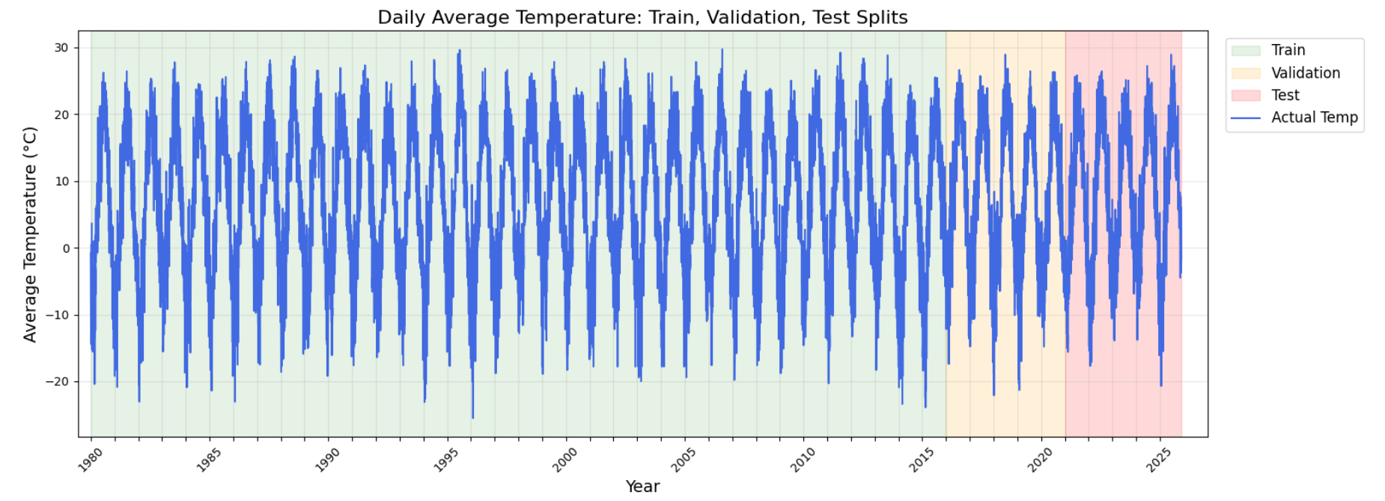
Raw data
Broadsoft Consulting Company

Slide 12
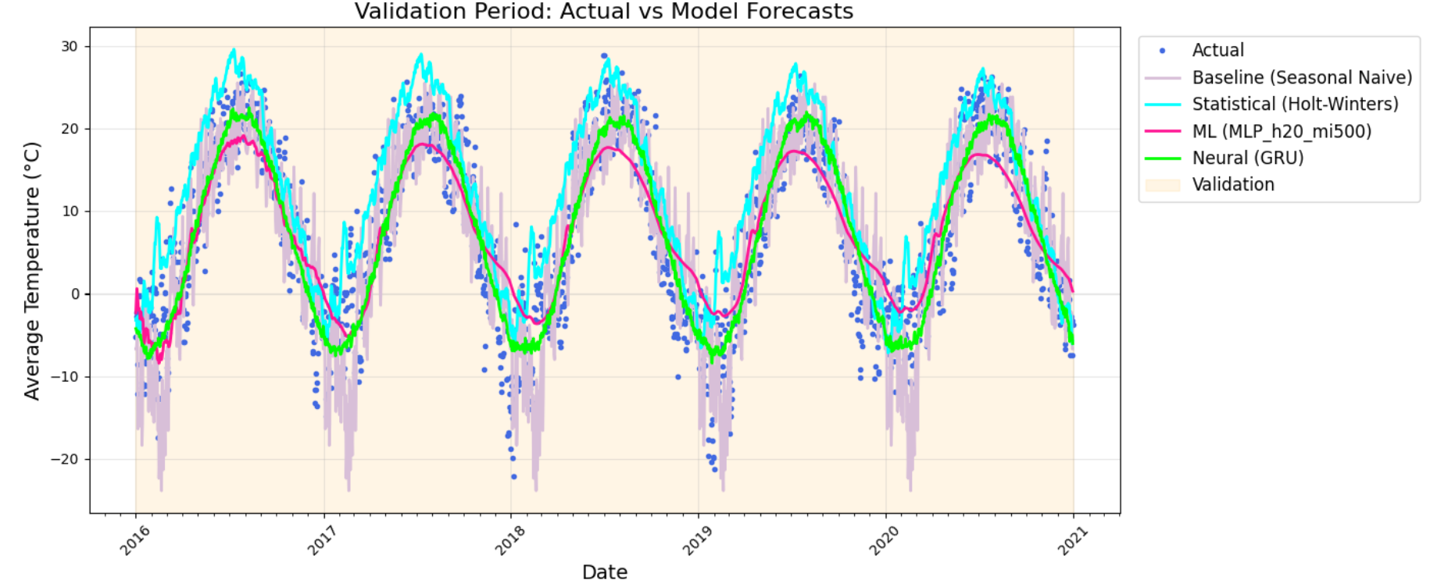
Val
Broadsoft Consulting Company
Family | MAE
Baseline | 5.1999
Statistical | 8.5890
ML | 4.2710
Neural | 3.6032

Slide 13
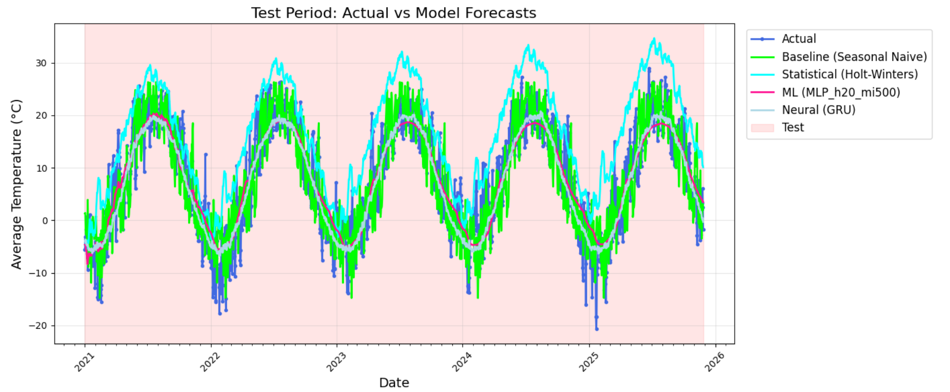
Test
Broadsoft Consulting Company
Family | MAE
Baseline | 4.8010
Statistical | 12.4058
ML | 3.9845
Neural | 3.5033

Slide 14
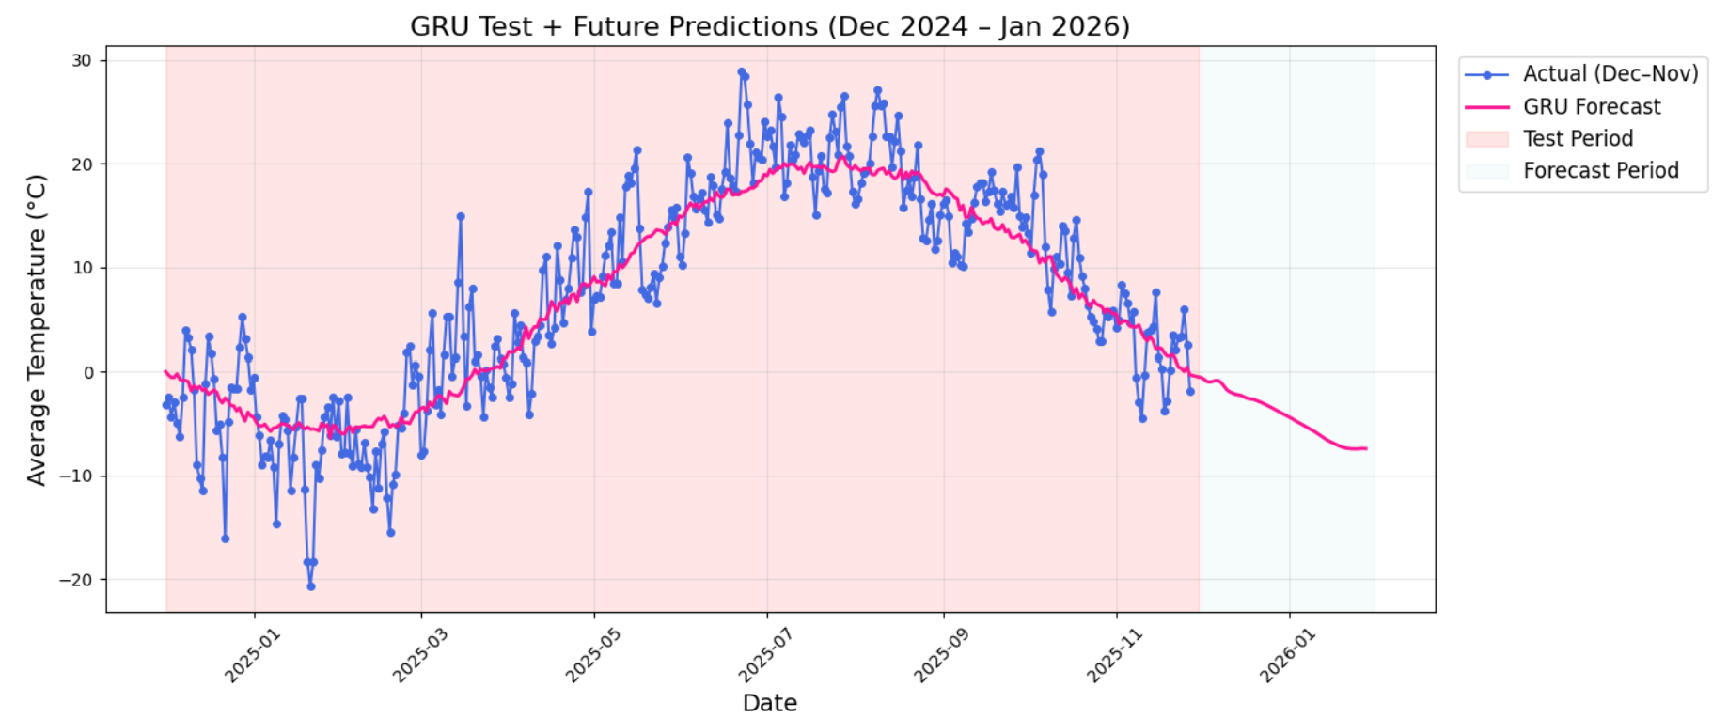
Forecast
Broadsoft Consulting Company

Slide 15

Broadsoft Consulting Company
Value
More reliable energy prediction
Case 1
LOGO
Case 2
Potential B2C use case

Slide 16
Broadsoft Consulting Company
Thank You
for your attention
xth January, 2026

